Slide 1





Farmington Hill Salesforce Developer Group
Salesforce Apex Hours
Topic Name
Speaker
Date
Venue/Link
Your Name
Saturday, JAN 11, 2020 10:00 AM EST ( 8:30 PM IST )
Online
#SalesforceApexHours
www.apexhours.com
#SalesforceApexHours

Slide 2
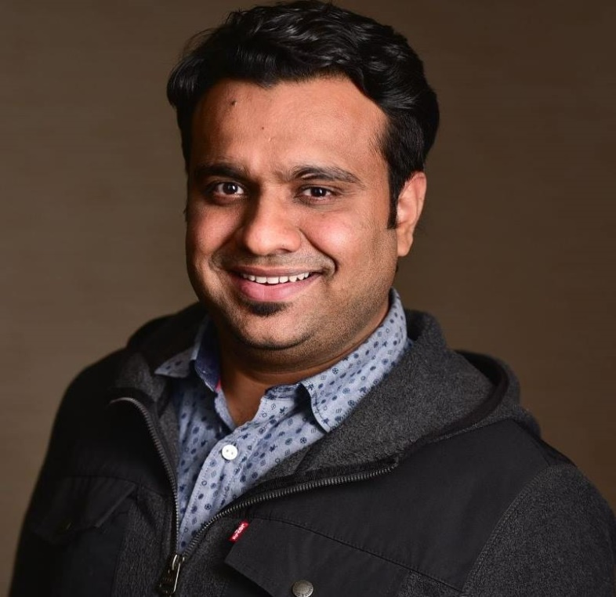
Who I am
Amit Chaudhary (Salesforce MVP)
Active on Salesforce Developer Community
Blogging at http://amitsalesforce.blogspot.in/
Co-Organizer of – FarmingtonHillsSFDCDug
Founder of www.ApexHours.com
Follow us @Amit_SFDC or @ApexHours

Slide 3
Upcoming session
Become an Order of Execution Hero on JAN 18, 2020 10:00 AM EST (8:30 PM IST) with Daniel Stange and Marc B. Kirsch
Salesforce integration Pattern & Best Practices on FEB 1, 2019 10:00 AM EST (8:30 PM IST) with Jitendra Zaa
Microservices in Salesforce on FEB 22, 2020 10:00 AM EST (8:30 PM IST) with Jigar Shah
RSVP Here : http://www.apexhours.com/sessions-in-2020/

Slide 4
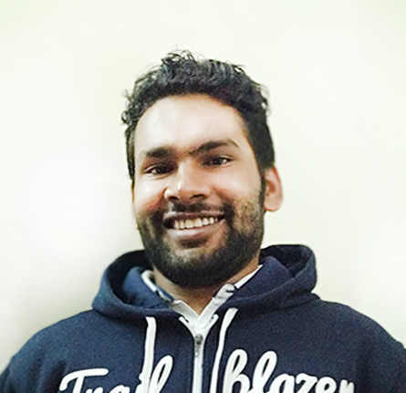


Our Speaker
Amit Singh
Certified Salesforce Application Architect
Community Leader & Speaker
Mulesoft Leader
Lightning & Analytics Champion
11x Certified
7X Ranger
@cloudyamit
/in/simplyamit

Slide 5
Agenda
Mulesoft Introduction
What is mule Event?
Conditional Routing of Requests
Error handling in mulesoft
Demos
Q & A

Slide 6
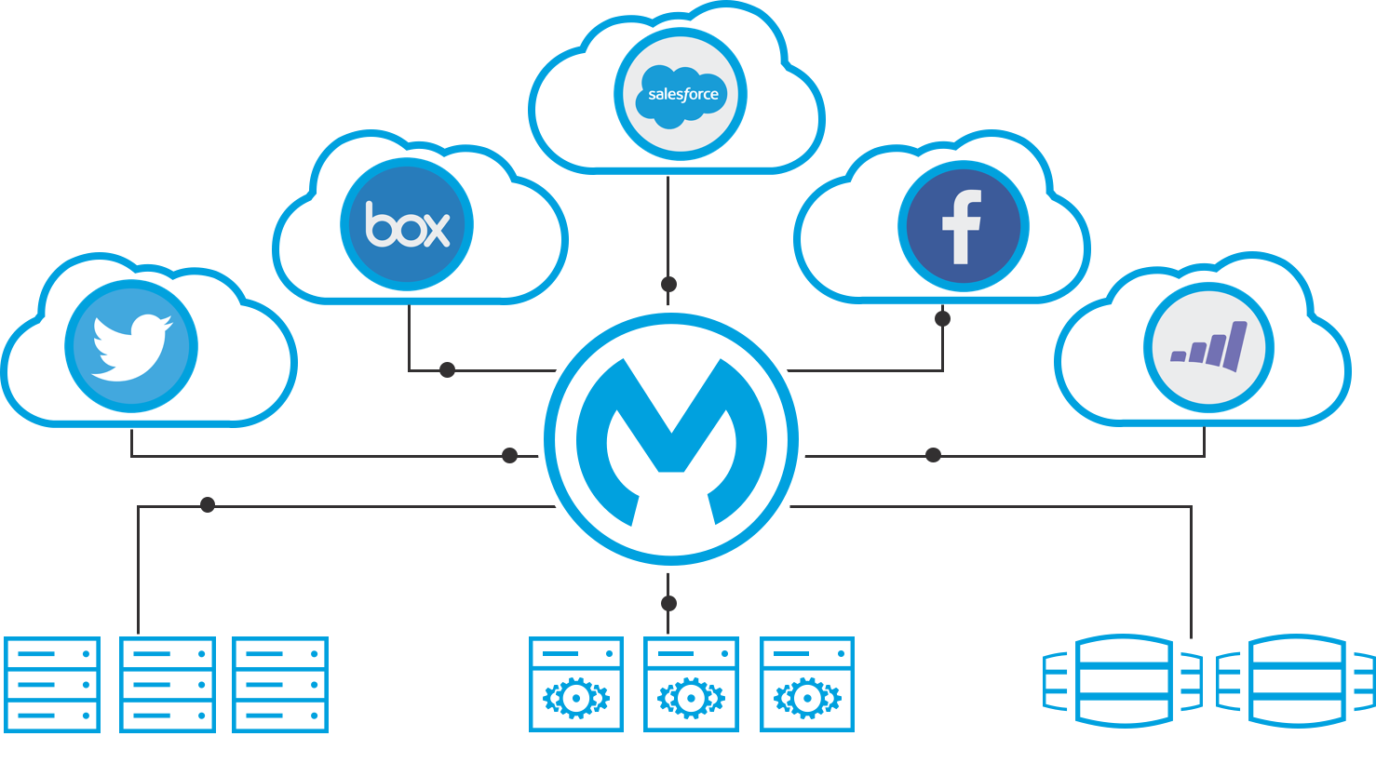
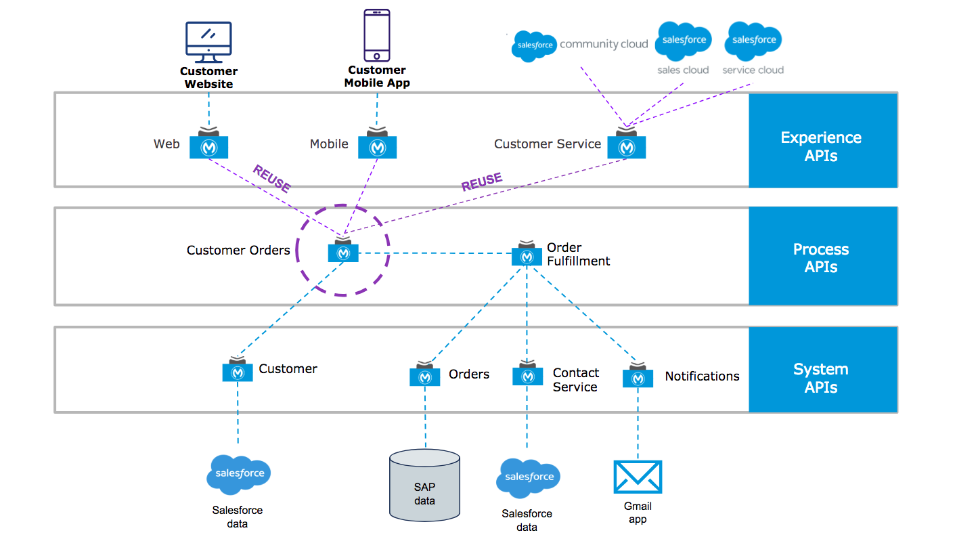
Introduction to mulesoft

Slide 7
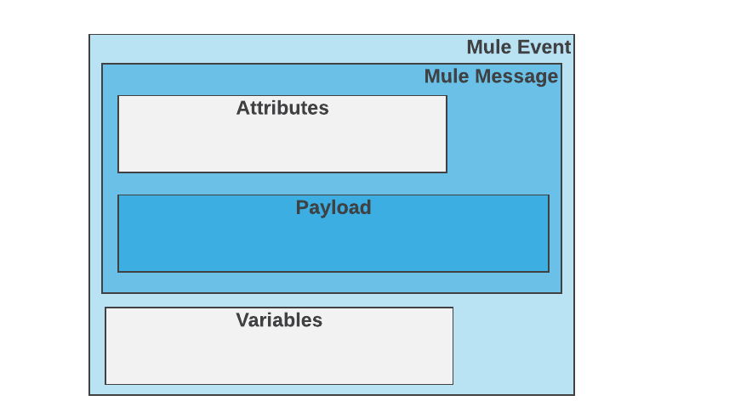
What is mule event
Mule Events contains the core information that application passes Runtime through various flows

Slide 8
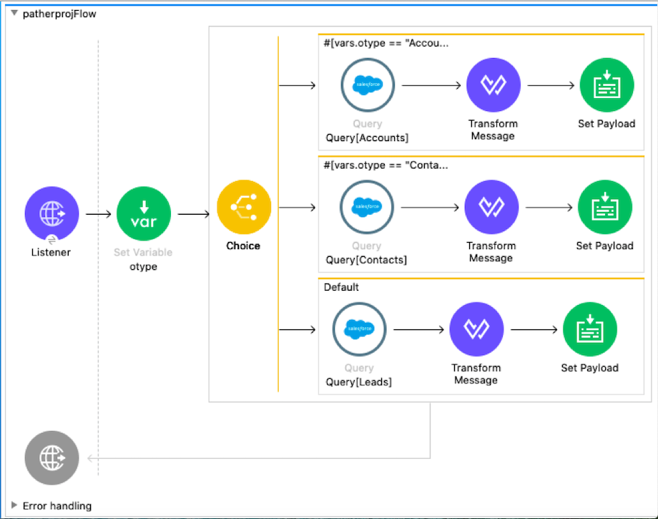
Conditional Routing of Events

Slide 9
Mulesoft : Error Handling
Default Error Handling
Global Error Handling
Flow Level Error Handling
Process Level Error handling

Slide 10
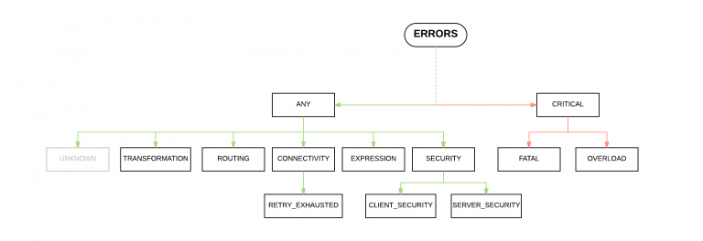
Mulesoft : Error Handling

Slide 11
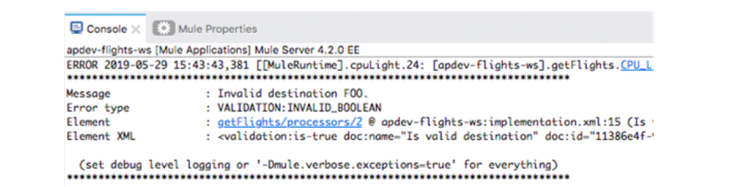
Default Error handler
If there is no error handler, “Default Error handler” is used
Globally Handles all the messages & error thrown in the mule application.
Stops the execution of the flow and logs information about the error
Can not be configured.

Slide 12
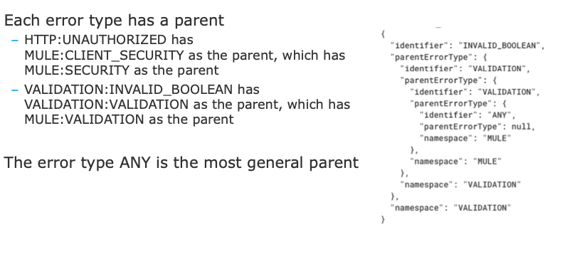
Default Error handler

Slide 13
Mulesift: Global Error handler
Each Error Handler Can contain one or more Error Scope
onError Continue
onError Propagate
Each Error scope can contains any no of Scope Parameters

Slide 14
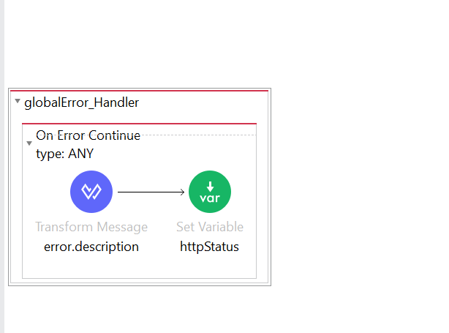

Slide 15
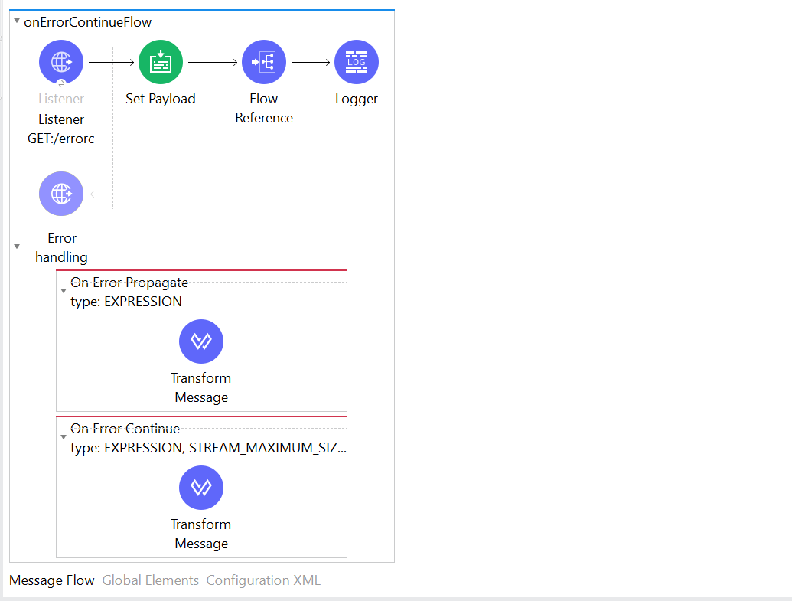
Flow Level Error Handling

Slide 17





Heading text goes here
#SalesforceApexHours @ApexHours
www.ApexHours.com
https://trailblazercommunitygroups.com/farmington-mi-developers-group/
https://www.youtube.com/channel/UChTdRj6YfwqhR_WEFepkcJw/videos
https://www.facebook.com/FarmingtonHillsSfdcdug/?ref=bookmarks

